Slide 1
Introduction to Generative AI
Justin Kauhl
GenAI Data Scientist Manager
The Dow Chemical Company
July 16th 2025

Slide 2





Justin Kauhl
5 Years :
Knowledge Processing Outsourcing (KPO)
B.A. Linguistics
2008
M.S. Computational Linguistics
2011
10 Years :
Advanced Analytics
GenAI Data Scientist Manager
Natural Language Processing (NLP)

Slide 3
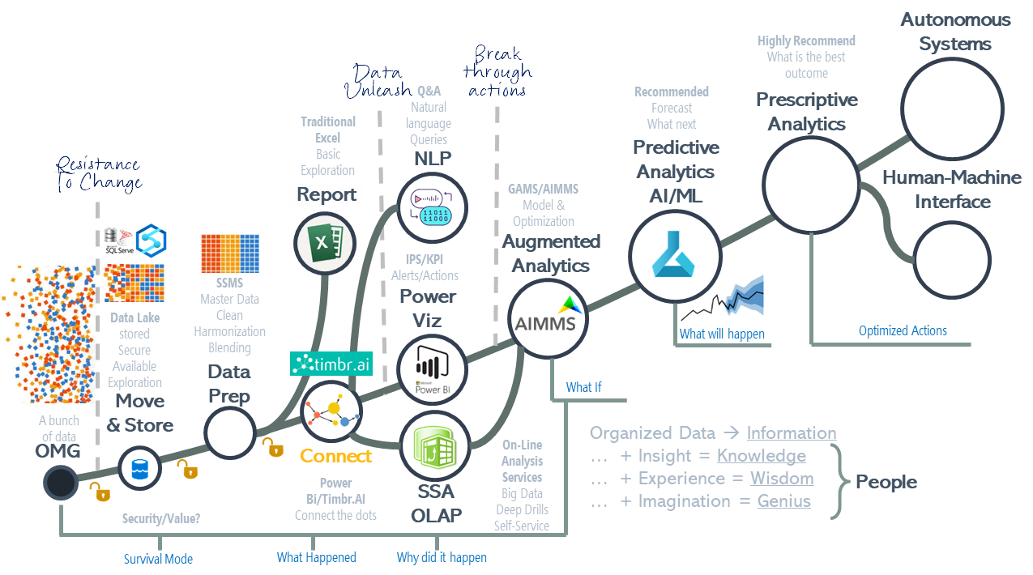
Data Science
AI combines computer science and robust datasets to enable problem-solving. It is a journey of leveraging data to drive informed actions and create intelligent solutions.

Slide 4
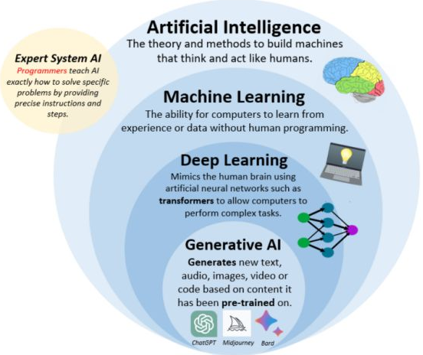
AI Terminology
Artificial Intelligence (AI): Systems that perform tasks requiring human intelligence, like problem-solving and decision-making.
Machine Learning (ML): A subset of AI where algorithms learn from data to make predictions or decisions.
Deep Learning: A specialized ML using neural networks with many layers to analyze data, effective for tasks like image and speech recognition.
Generative AI: AI that creates new content, such as text, images, and music, by learning from existing data.
Models: Large algorithms that ‘model’ a system. A simulacrum or emulation of a real environment which takes an input and creates an output.

Slide 5
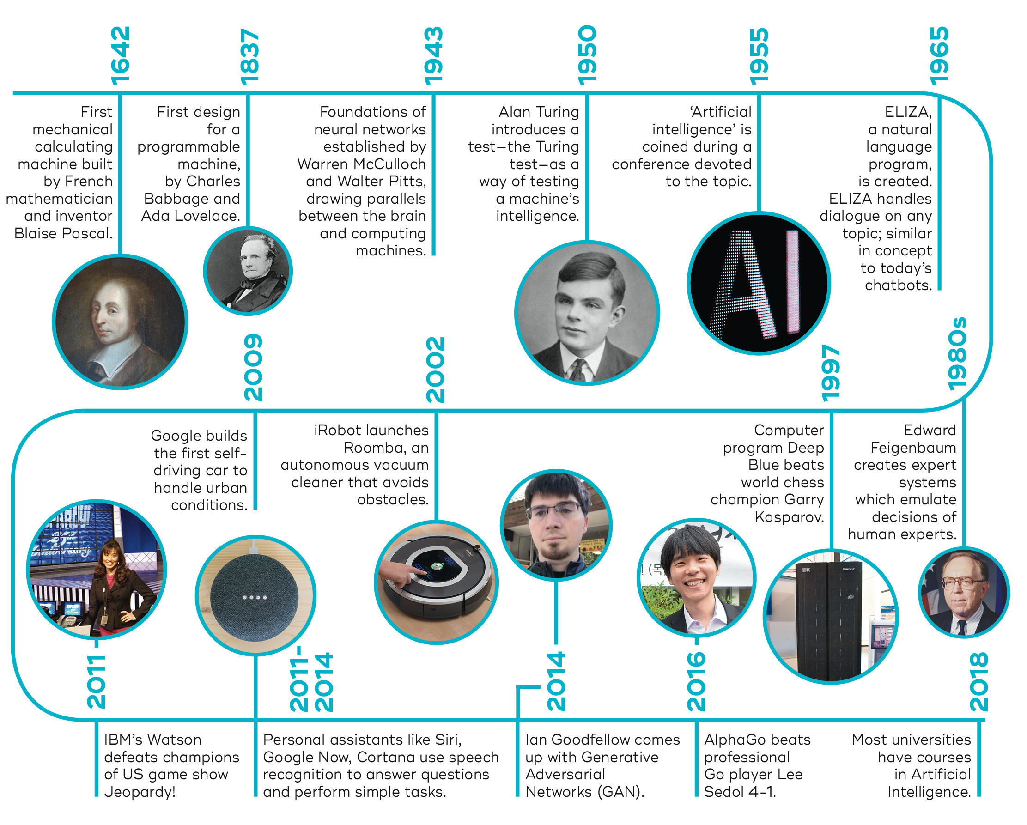
Famous Models Through History (The math kind)
The Problem: Calculate sums electronically.
- The Arithmometer – 1820
The Problem: Help me make the optimal decision.
- Decision Trees - 1936’s
The Problem: Where am I?
- NAVSTAR GPS - 1960
The Problem: Output text to behave as a therapist chatbot.
- ELIZA - 1965
The Problem: Beat the worlds best chess player.
- Deep Blue - 1997
The Problem: Drive this car for me.
- Google Self-Driving cars - 2009
The Problem: Win Jeopardy!
- IBM Watson - 2011
The Problem: Draw me a picture
- Generative Adversarial Network (GAN) - 2014
The Problem: Learn to speak
- Transformer Architecture - 2017
From basic addition to making impossible tasks easy

Slide 6
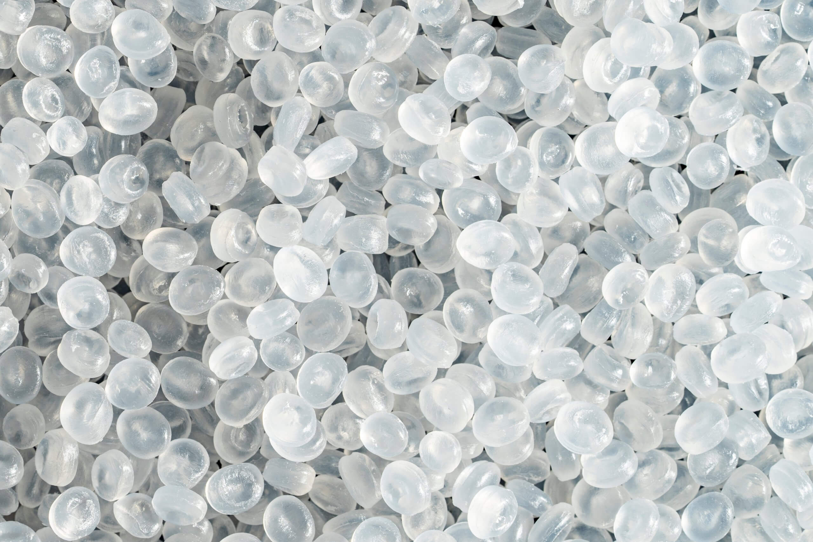

Models
The Problem: I have {x} drums of polyethylene pellets, how many injection molds{z} for product {y} can I run before I need to order more?
Inputs
Called variables, features, embeddings, etc
The Model
Output
Volume of Pellets/Shot (52,832 oz)
Human
interpretation:
Volume per product (40 oz)
Numbers made-up, injection molding experts please forgive me.

Slide 7
Models
The Problem: I have {x} drums of polyethylene pellets, how many injection molds{z} for product {y} can I run before I need to order more?
Inputs
Called variables, features, embeddings, etc
The Model
{x}/{y}={z}
Volume of pellets / Volume per product = Number of molds
52832/40=
Output
Volume of Pellets/Shot (52,832 oz)
Human
interpretation:
Volume per product (40 oz)
Numbers made-up, injection molding experts please forgive me.

Slide 8
Models
The Problem: I have {x} drums of polyethylene pellets, how many injection molds{z} for product {y} can I run before I need to order more?
Inputs
Called variables, features, embeddings, etc
The Model
{x}/{y}={z}
Volume of pellets / Volume per product = Number of molds
52832/40=
Output
1,320.8
Volume of Pellets/Shot (52,832 oz)
You can make 1,320 of these with the amount of pellets you have.
Human
interpretation:
Volume per product (40 oz)
Numbers made-up, injection molding experts please forgive me.

Slide 9
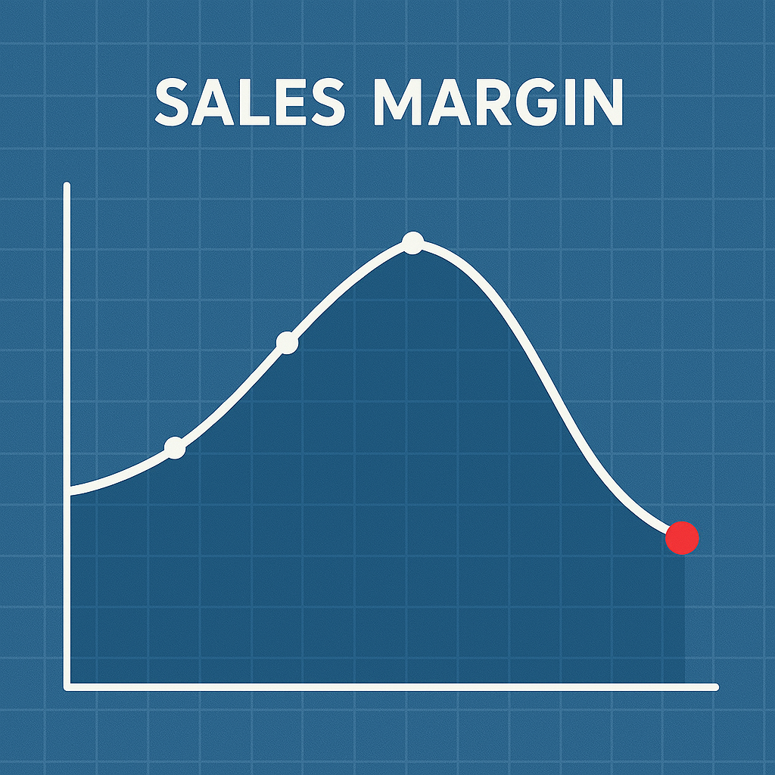
Models (But it is never that easy)
The Problem: I am the CEO of an injection molding business. Margin last quarter was down from last year. I need to know what kind of sales to expect for next quarter to be able to communicate this with my stakeholders.
Inputs
Called variables, features, embeddings, etc
The Model
The Y Variable: What we are trying to predict.
Output
Given what we know about our past...

Slide 10
Models (But it is never that easy)
The Problem: I am the CEO of an injection molding business. Margin last quarter was down from last year. I need to know what kind of sales to expect for next quarter to be able to communicate this with my stakeholders. I believe that the price of oil is driving up my costs. But it could be other factors.
Inputs
Called variables, features, embeddings, etc
The Model
The Y Variable: What we are trying to predict.
Output
Given what we know about our past...
Sales History
Volume History
Price Changes
Customer Churn
Order Fulfillment Rate
Customer Satisfaction
Global Oil Prices
Competitive Market Share
Surrogate Product Sales
Etc..
The X Variable: The influencing factors.

Slide 11
Models (But it is never that easy)
The Problem: I am the CEO of an injection molding business. Margin last quarter was down from last year. I need to know what kind of sales to expect for next quarter to be able to communicate this with my stakeholders. I believe that the price of oil is driving up my costs. But it could be other factors.
Inputs
Called variables, features, embeddings, etc
The Model
The Y Variable: What we are trying to predict.
ARIMAX Model
Output
P_{t}=c+βX+ϕ₁ P_{t-1}+ θ₁ ϵ_{t-1} +ϵ_{t}
P=Observation period
t: The number of lag observations included in the model (lag order).
c: The constant variable
q: The size of the moving average window (order of moving average).
X: The exogenous variables that are included in the model.
Y: The dependent variable that we are trying to predict.
ϕ (phi): The coefficients for the autoregressive terms.
θ (theta): The coefficients for the moving average terms.
β (beta): The coefficients for the exogenous variables.
ε (epsilon): The error term (residuals).
Given what we know about our past...
Sales History
Volume History
Price Changes
Customer Churn
Order Fulfillment Rate
Customer Satisfaction
Global Oil Prices
Competitive Market Share
Surrogate Product Sales
Etc..
The X Variable: The influencing factors.
Machine Learning: The machine needs to “Learn” patterns and weights on its own.
AutoRegressive Integrated Moving Average with eXogenous inputs (ARIMAX) models excel when doing time-series forecasting. (AKA Predicting the future).
Exogenous means external to. So, Exogenous Inputs are factors from outside the observation. Internal & external forces; market trends, price fluctuations, anything that impacts the problem.

Slide 12
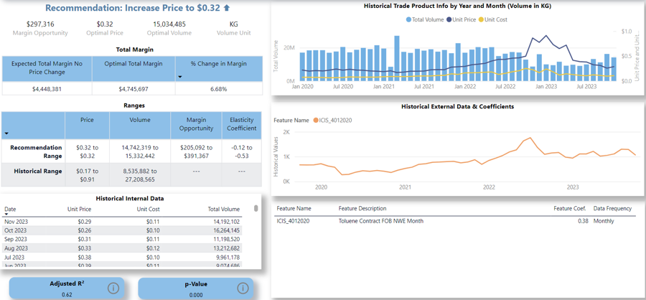
Models (But it is never that easy)
The Problem: I am the CEO of an injection molding business. Margin last quarter was down from last year. I need to know what kind of sales to expect for next quarter to be able to communicate this with my stakeholders. I believe that the price of oil is driving up my costs. But it could be other factors.
Inputs
Called variables, features, embeddings, etc
The Model
The Y Variable: What we are trying to predict.
ARIMAX Model
Output
P_{t}=c+βX+ϕ₁ P_{t-1}+ θ₁ ϵ_{t-1} +ϵ_{t}
P=Observation period
t: The number of lag observations included in the model (lag order).
c: The constant variable
q: The size of the moving average window (order of moving average).
X: The exogenous variables that are included in the model.
Y: The dependent variable that we are trying to predict.
ϕ (phi): The coefficients for the autoregressive terms.
θ (theta): The coefficients for the moving average terms.
β (beta): The coefficients for the exogenous variables.
ε (epsilon): The error term (residuals).
...Predict our future.
Given what we know about our past...
Sales History
Volume History
Price Changes
Customer Churn
Order Fulfillment Rate
Customer Satisfaction
Global Oil Prices
Competitive Market Share
Surrogate Product Sales
Etc..
The X Variable: The influencing factors.
Machine Learning: The machine needs to “Learn” patterns and weights on its own.
Human interpretation: Sales will continue to be down in the next quarter. Customer churn from poor fulfillment satisfaction is impacting more than oil prices.
AutoRegressive Integrated Moving Average with eXogenous inputs (ARIMAX) models excel when doing time-series forecasting. (AKA Predicting the future).
Exogenous means external to. So, Exogenous Inputs are factors from outside the observation. Internal & external forces; market trends, price fluctuations, anything that impacts the problem.

Slide 13
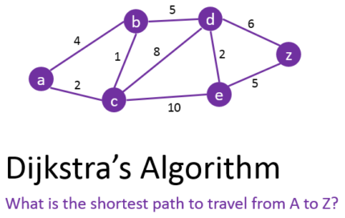


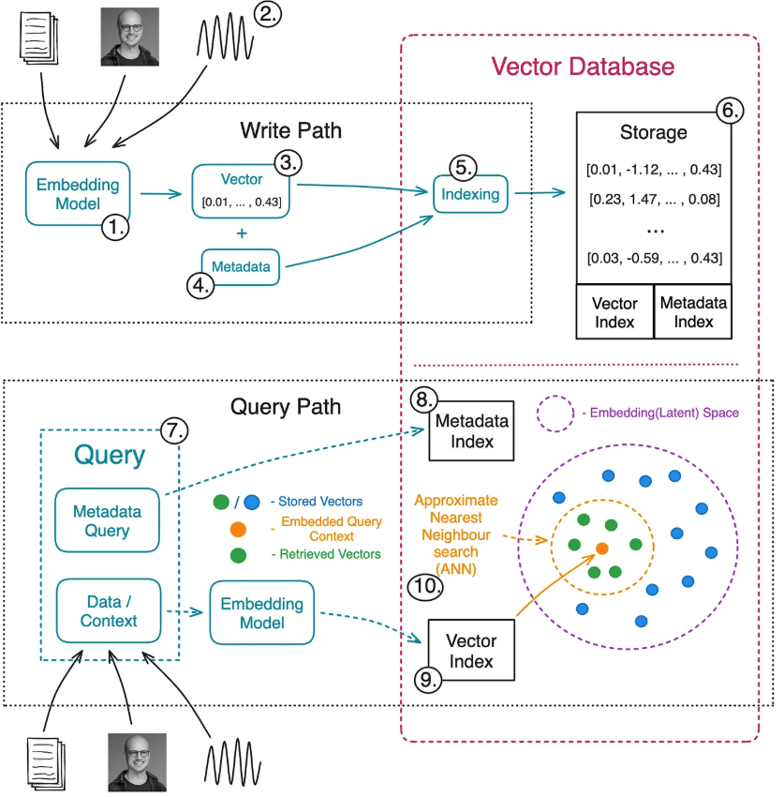
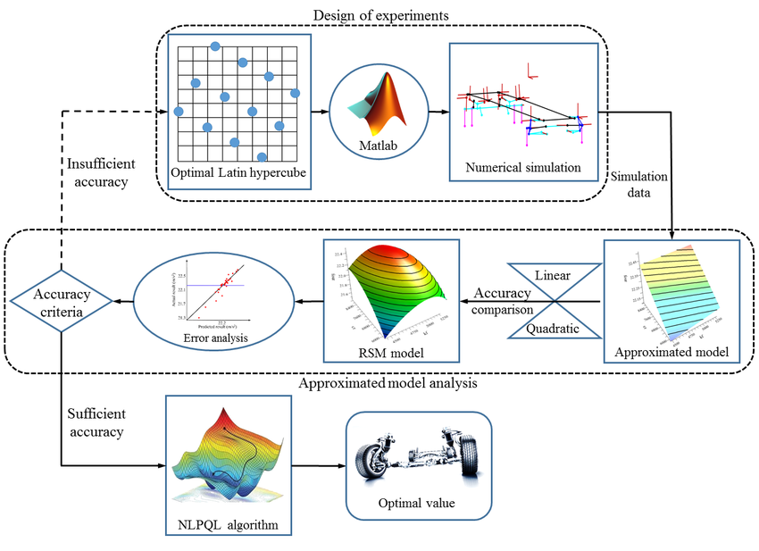
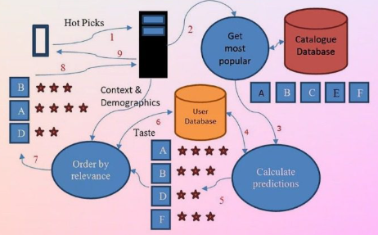
“The Algorithm”
The Algorithm is just a very large complicated model.
Most people interact with algorithms every single day
Map & Travel Software
Recommendation Systems
Search Engines
Optimization

Slide 14


Models (The most complicated calculation ever?)
The Problem: I need an artificially intelligent system that can convincingly interact with humans to solve any problem they have using natural language, images, audio, video, etc…
Inputs
Output
The Model
All human knowledge

Slide 15
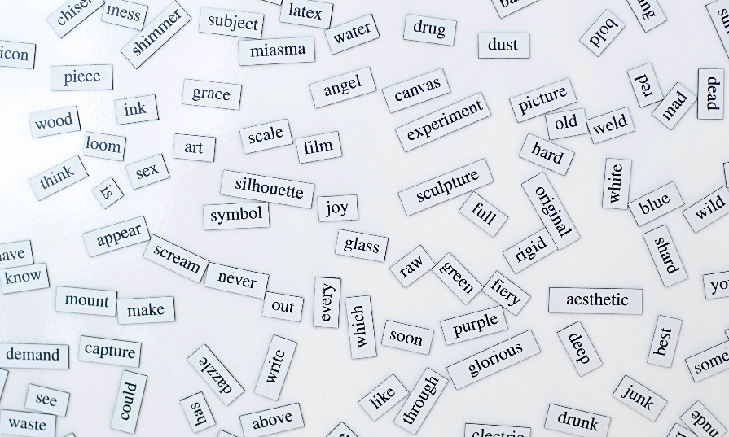
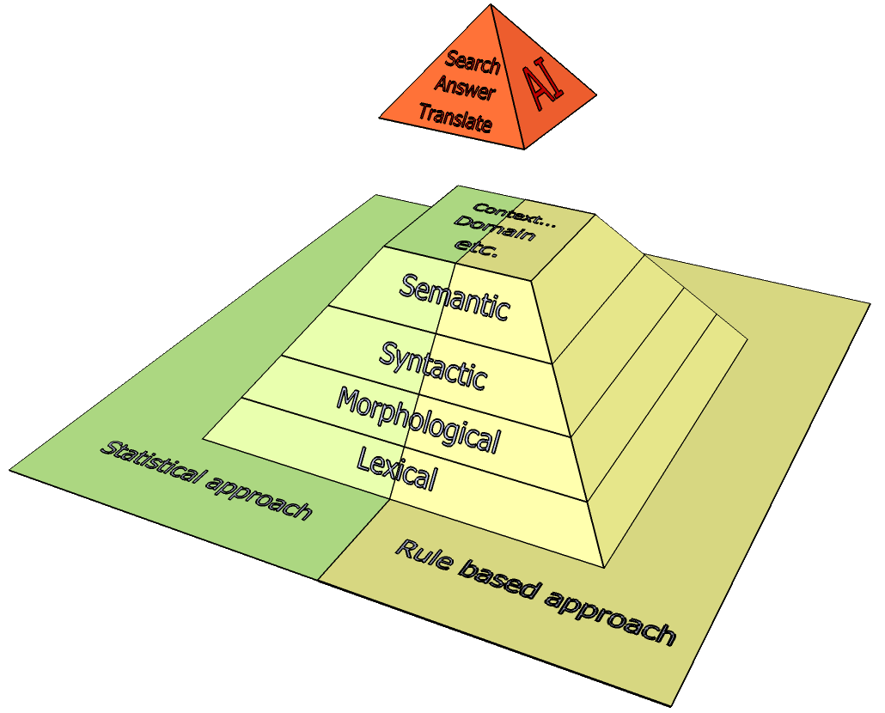
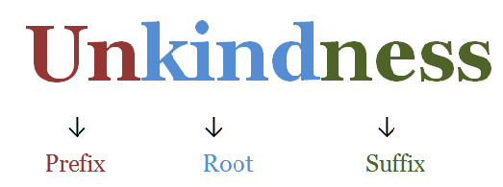
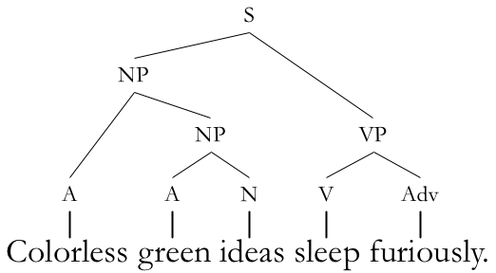
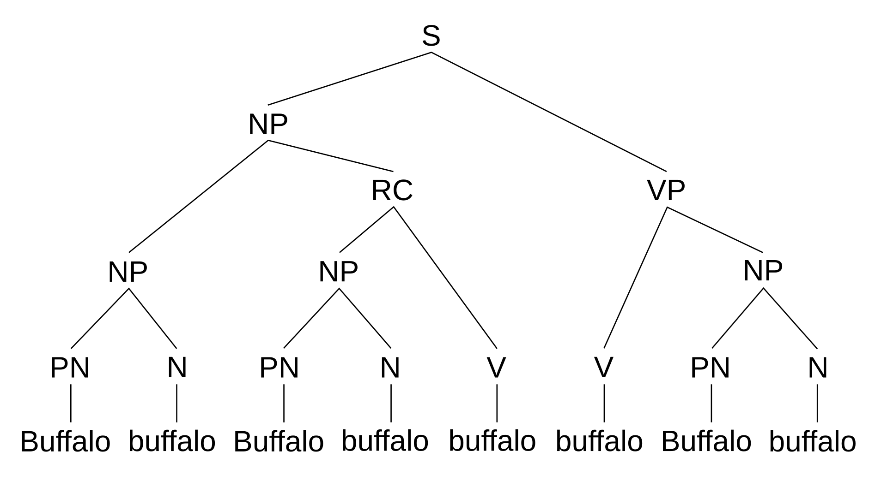
Language
Language is extremely complicated.
We may take it for granted, but just speaking to another human is a miracle of evolution. It is wireless communication between brains (neural networks).
Grammar is just an analog version of a language model
Computers do not understand language. Understanding requires concrete association. Even these new AI systems do not understand it. They simply understand the math and probability of words.
Ambiguity in language
“I shot an elephant in my pajamas. How he got into my pajamas, I will never know.”
- Groucho Marx
Time flies like an arrow; fruit flies like a banana.
Buffalo buffalo Buffalo buffalo buffalo buffalo Buffalo buffalo

Slide 16

OpenAI Launches ChatGPT
November 30, 2022

Slide 17
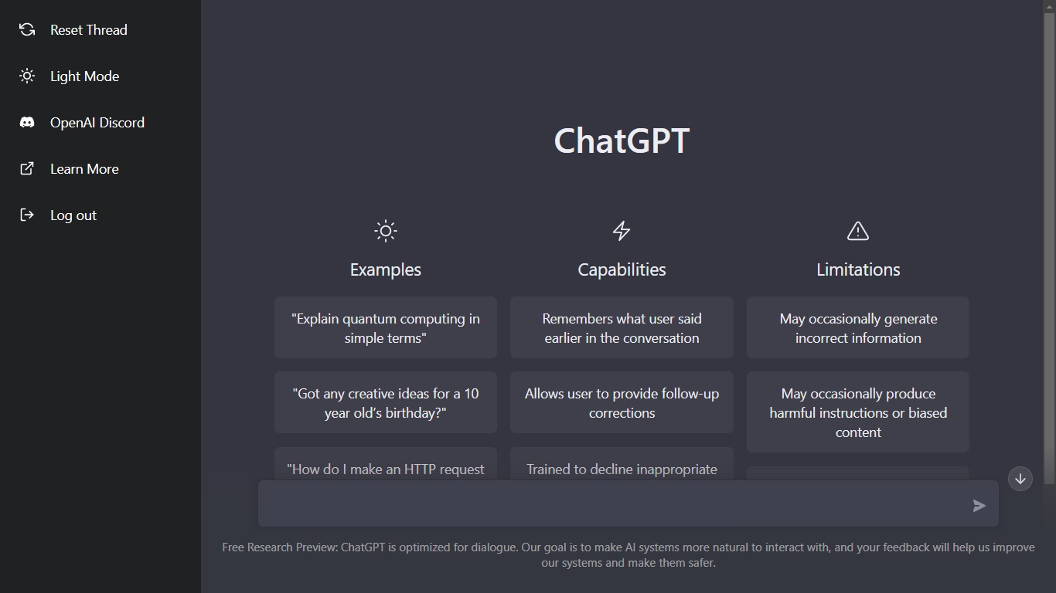
A breakthrough
Google made the first Large Language Models (LLM)
OpenAI made it a free product
A live chat that speaks like a person
It seems to know everything
“Not as well as I do, of course, but some of my coworkers surely”
It grew smarter very quickly

Slide 18
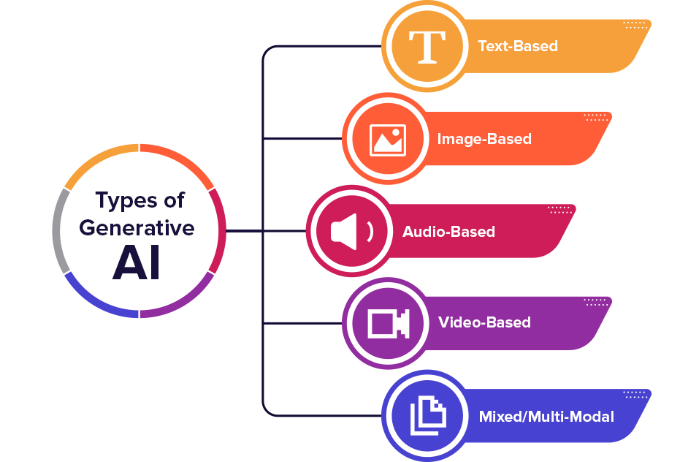





Generative AI Today
Generative AI is a type of artificial intelligence that can create new content, such as text, images, or music, based on patterns it has learned from existing data. It mimics the styles and structures it has been trained on.

Slide 19
RVWA as AI Understands It
Recreational Vehicle Women’s Alliance (RVWA) Overview
History
Year Founded: The RVWA was formally launched in 2019.
Founding Purpose: The organization was created in response to a recognized lack of support, visibility, and networking opportunities for women in all sectors of the RV (Recreational Vehicle) industry.
Creation: The launch followed several years of discussion among female industry professionals seeking to address underrepresentation and create a more inclusive environment.
Mission:
“To elevate, educate and promote women in the RV industry, making the RV industry a place where women thrive.”
Key Focus Areas:
Professional Development: Providing education, leadership training, and networking opportunities for women at all career stages.
Industry Awareness: Raising the visibility of women in the RV sector and highlighting the value of gender diversity for organizations.
Creating Community: Fostering connections among women working in RV manufacturing, suppliers, dealers, campground operation, marketing, publishing, and associated fields.
Role and Contributions in the RV Industry
1. Education & Professional Development
Workshops and Seminars: RVWA regularly hosts in-person and virtual events on topics ranging from leadership to technical skills.
Mentorship Programs: Pairs women new to the industry with veterans for support and career guidance.
Industry Partnerships: Collaborates with organizations like the RV Industry Association (RVIA), RV Dealers Association (RVDA), and others for educational programming.
2. Advocacy & Awareness
Industry Research: RVWA gathers data and insights on women’s roles and participation in the RV industry, using the information to advocate for increased inclusivity.
Promotional Campaigns: Runs initiatives during events like RV Women’s Day (held during RV industry shows), highlighting women's contributions in the sector.
Speaking Engagements: Utilizes panel discussions, speaking slots at conventions, and media to put a spotlight on industry women leaders.
3. Community-Building & Networking
Membership: Open to women and men; includes individuals from manufacturers, suppliers, dealers, campgrounds, and RV-focused media.
Events: Regular events at major industry gatherings such as RVX, Elkhart Open House, and others.
Notable Achievements & Contributions
Ladies Who RV” Event : A prominent, hands-on event that helps women learn RV technical basics—such as operating systems, repairs, and maintenance. This supports not only professionals but also end-user women RVers.
Breaking Glass Ceilings : Several RVWA board members and participants have advanced to top leadership roles in major RV organizations, setting a precedent for aspiring women in the field.
Diversity, Equity & Inclusion (DEI) Advocacy : RVWA has been at the forefront of championing DEI initiatives within the RV industry, influencing HR policies and corporate cultures in many member companies.
Annual “Influential Women in RV” Recognitions : RVWA recognizes and celebrates exceptional women at annual industry events, inspiring others and bringing positive attention to underrepresented talent.
MentorMatch Program : Launched a formal mentorship program to connect mentees with experienced professionals for career development, leadership, and personal growth.
Industry Surveys & Benchmarking : Commissioned studies that shed light on female representation and challenges within the RV sector, sparking dialogue and policy changes.
Industry Impact
Improved Representation: The RVWA’s work has led to increased female participation—and recognition—in industry leadership, technical, and engineering roles.
Stronger Industry Image: By promoting inclusivity, the RV industry is more appealing and accessible to a diverse talent pool.
Stronger Networks: Professionals have access to a robust support system, promoting retention and advancement for women in what has traditionally been a male-dominated sector.
Additional Info
Membership Size: As of the early 2020s, the group had attracted hundreds of members, with a presence at most major RV industry events.
Leadership: The alliance is governed by a board of directors comprised of prominent women (and some men) from all reaches of the RV world.
References:
[RVWA Official Website](https://rvwa.org)
Coverage from industry media such as RVBusiness, RVPro, and the RV Industry Association.
Credit: OpenAI – GPT 4.1

Slide 20


GenAI Images
Above: “Generate an image that best represents the RVWA.”
Right: “Generate an image of an AI camping”
Credit: Microsoft Copilot

Slide 21
Let’s play a game – Finish the Phrase
1) I pledge allegiance to the ____ of the United States of America.
- USA Pledge of Allegiance
- flag
2) You can’t handle the ____ !
- A Few Good Men (1992)
- truth
3) We’re gonna need a ____ boat.
- Jaws (1975)
- bigger
The Problem: Fill in the blank
So, how did you do?
But more importantly…
… how did you do it?

Slide 22
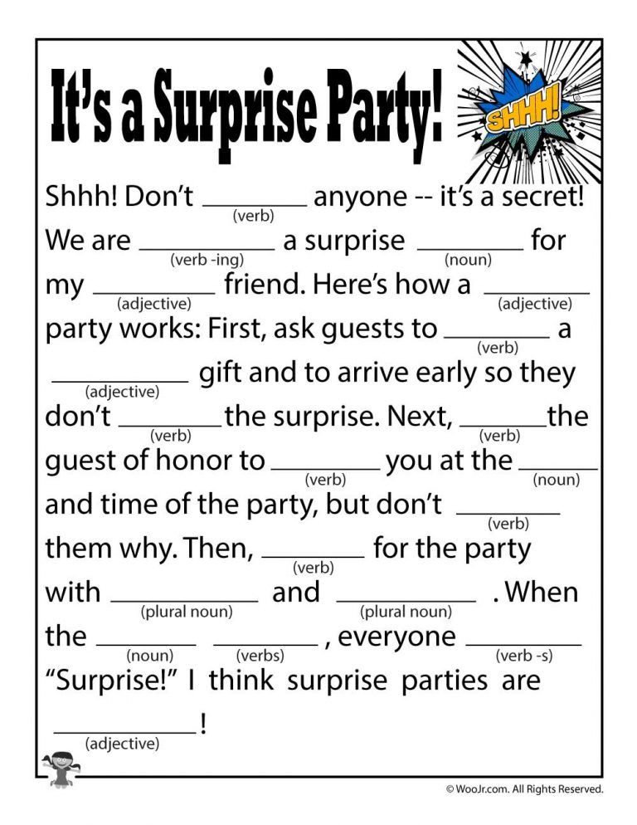
Training a Language Model

Slide 23



How to train your LLM
In the heart of the bustling city, nestled between towering skyscrapers and neon-lit cafés, stood a small bookstore that time seemed to have forgotten. Its wooden sign, faded by decades of sun and rain, read Whispers & Pages.
In the heart of the bustling city, nestled between towering skyscrapers and neon-lit cafés, stood a small bookstore that time seemed to have forgotten. Its wooden sign, faded by decades of sun and rain, read Whispers & Pages
Get as much data as possible
Guess the missing words and calculate for the error
Encode all patterns using math. *
*Math omitted for public decency.

Slide 24
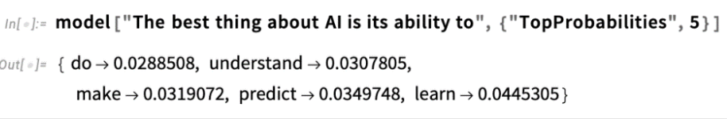

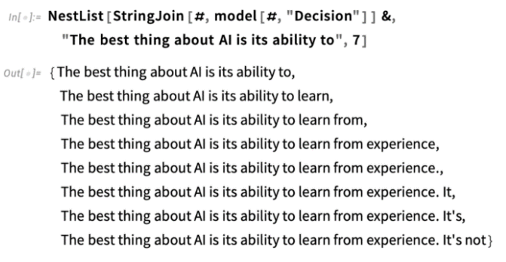
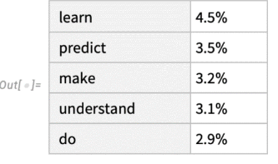
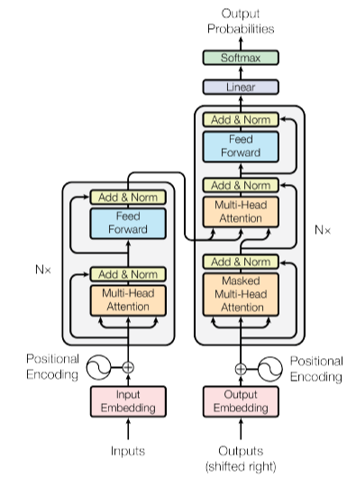
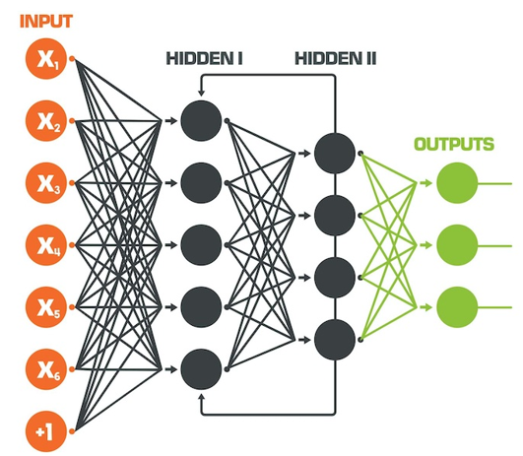
What is a Large Language Model (LLM)
Generative pre-trained transformer (GPT)
Trained on diverse internet text (unsupervised), then fine-tuned by OpenAI on specific datasets for safety and reliability.
User input is transformed into tokens which the model interprets to predict a response.
GPT-3 was built using
  60% Common Crawl – General web crawling
  22% WebText2 – Reddit Data
  15% Books1 & Books2 – Digital book databases
  3% Wikipedia
  GPT-4 has ~1.8 trillion parameters across 120 layers trained on ~13T tokens

Slide 25
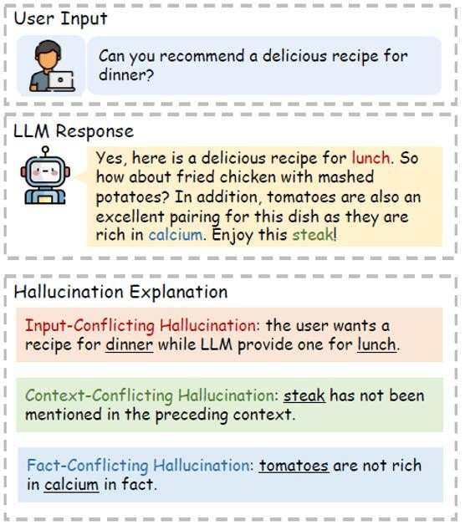

LLMs Are Good, But…
Why does my chatbot get technical details wrong?
Generating incorrect information or making up the answer which is sometimes difficult for human to notice – Hallucinations
LLMs generate the next most likely word using past observations and context.
Stochastic parrot

Slide 26
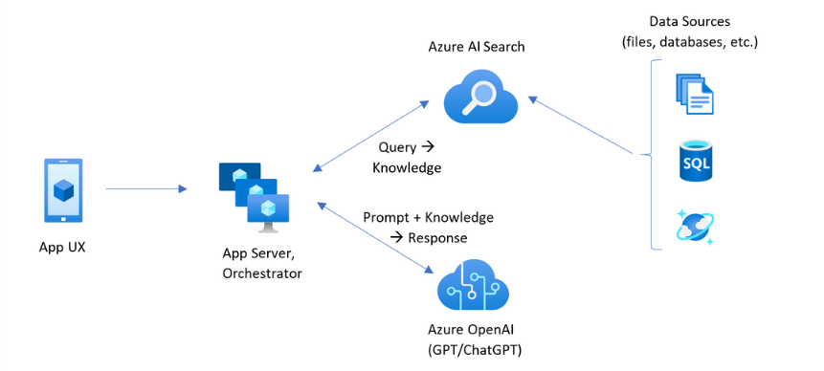
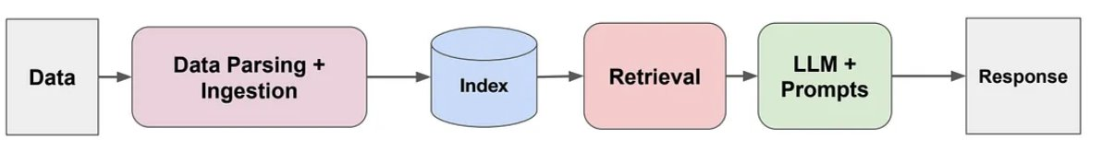
…But it doesn’t know MY data.
Retrieval Augmented Generation (RAG)
How to get a LLM trained to your domain.
Build: Train on your own annotated data (The training costs for GPT-4 was around $63 million)
Fine Tuning: Adjusting the weights of a pre-trained model to specialize in specific tasks.
Reinforcement learning from human feedback (RLHF): An advanced training technique where the model learns from human feedback to make decisions or generate outputs that align more closely with human judgment or preferences.
Retrieval Augmented Generation (RAG): Combines the generative capabilities of LLMs with the retrieval capabilities of search. Allowing the model to pull in information from external databases or text to inform its responses.
Data “grounding”
Relatively easy to set up
No training required
Providing context within the prompt
Image Source: “Retrieval-Augmented Generation overview,” Microsoft Azure, https://learn.microsoft.com/en-us/azure/search/retrieval-augmented-generation-overview

Slide 27
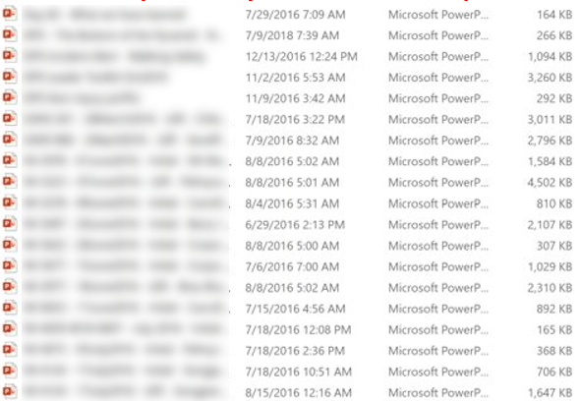
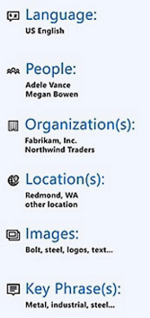


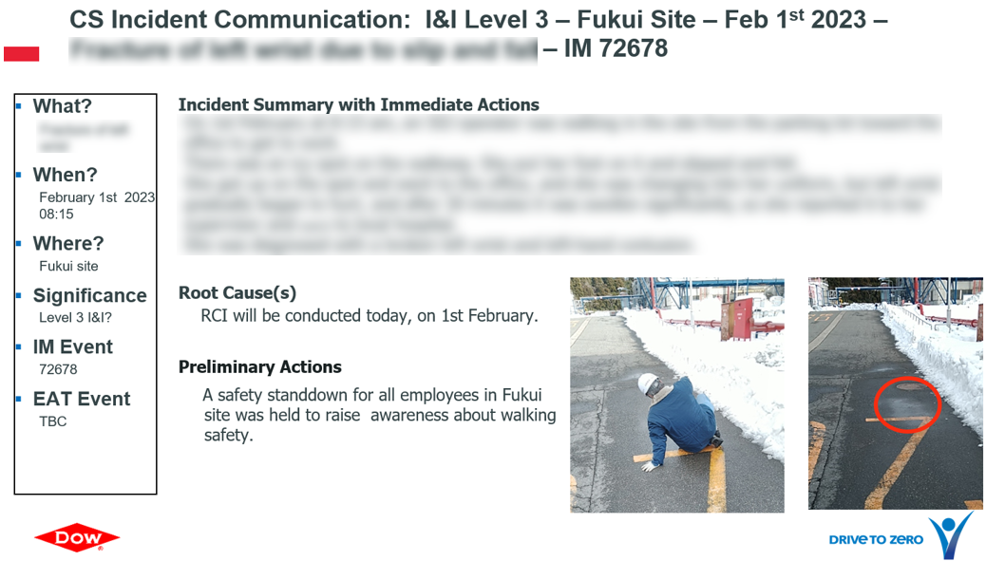


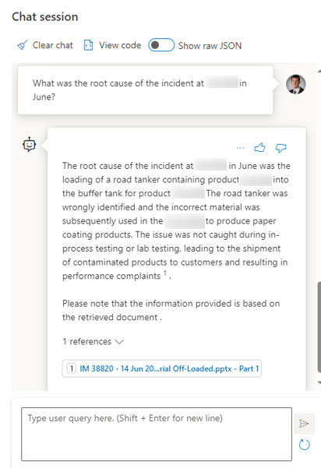

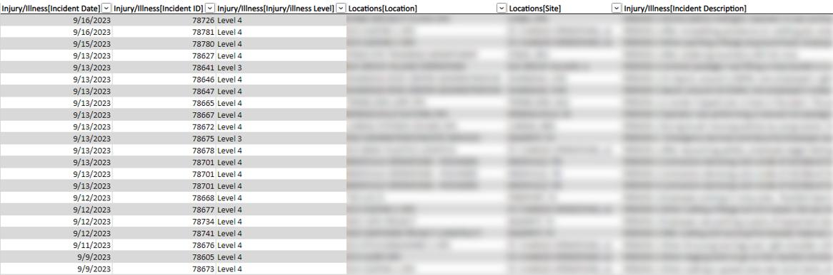
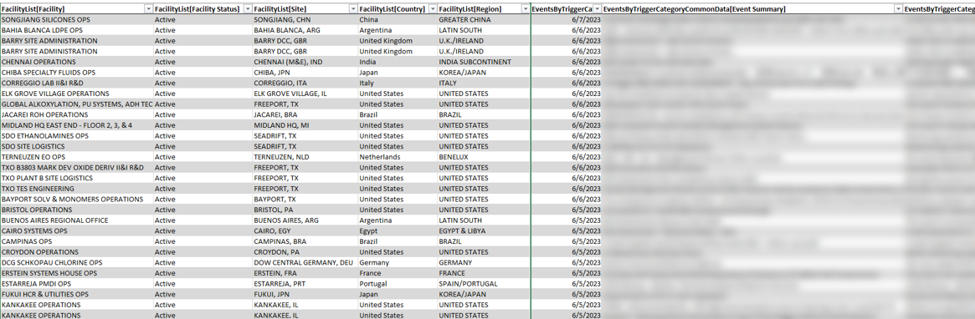

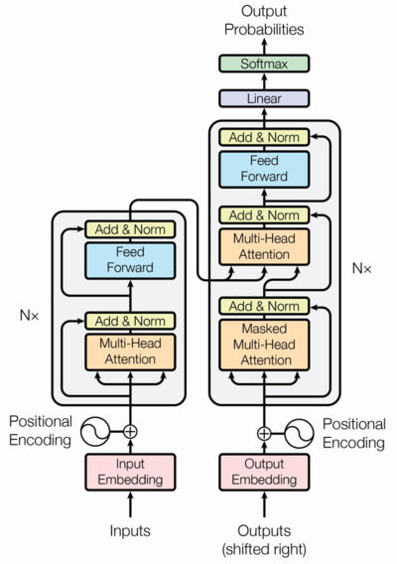
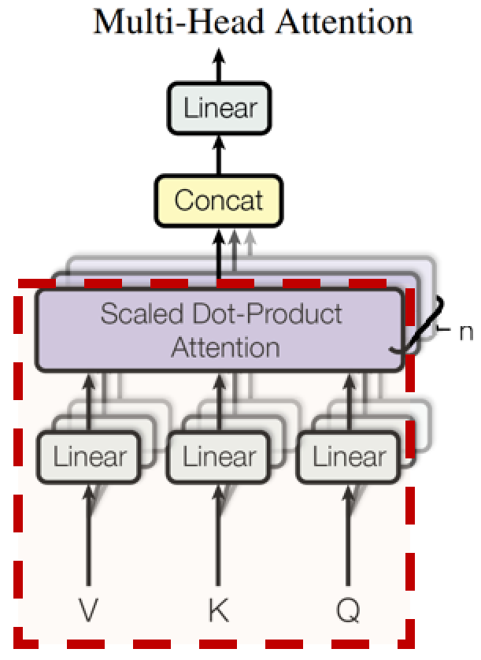
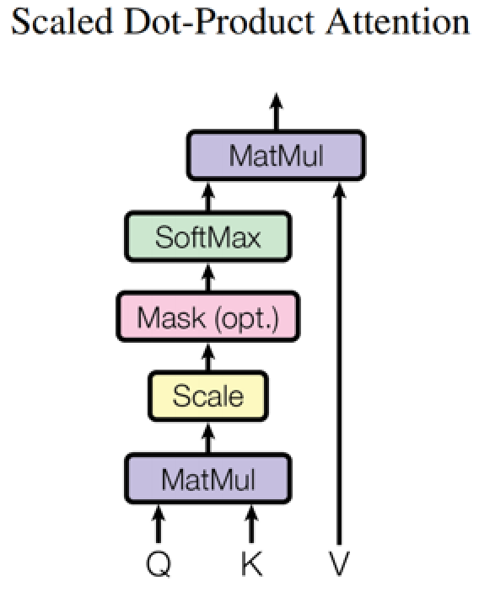
Retrieval Augmented Generation In Practice
Case Study: Safety Strategy Using EH&S Incident Reports Powered by Azure & OpenAI
How can we ask specific questions to our data?
Plant Safety Incidents
(Multiple Formats)
How can we quickly review all our historical incident reports and come to the best answer?
NLP Uplift
Vectorization
Embedding
Search Indexing
Large Language Models (LLM) are transforming AI, but not all organizations can afford the huge cost to train, or the vast annotated data and extensive hours needed for fine-tuning.
By integrating search engines, NLP, and LLMs, we can instantly ask databases natural language questions and receive knowledgeable answers.
Vector Search
Incident Reports
Regular Data Updates
1) User queries are used to fetch relevant data.
Interactive Dashboard
No special skills or training are needed!
Optional preprocessing
RAG Framework
2) Relevant data is sent along with the query to the LLM
The strength of LLMs lies in their ability to capture general language, enabling accurate interpretation of supplied data across various domains.
Hub
Application Server
IM: Incident Management
3) An informed response is formulated and generated for the user
EAT: Event and Action tool
Designed to better process sequentially dependent data, the transformer is the basic logical unit and the powerhouse of the LLM.
Attention is a mechanism that allows models to selectively concentrate on parts of the input that are more relevant.
OpenAI. (2023). GPT-4 Technical Report. arXiv:2303.08774 [cs.CL]. Retrieved from https://doi.org/10.48550/arXiv.2303.08774

Slide 28
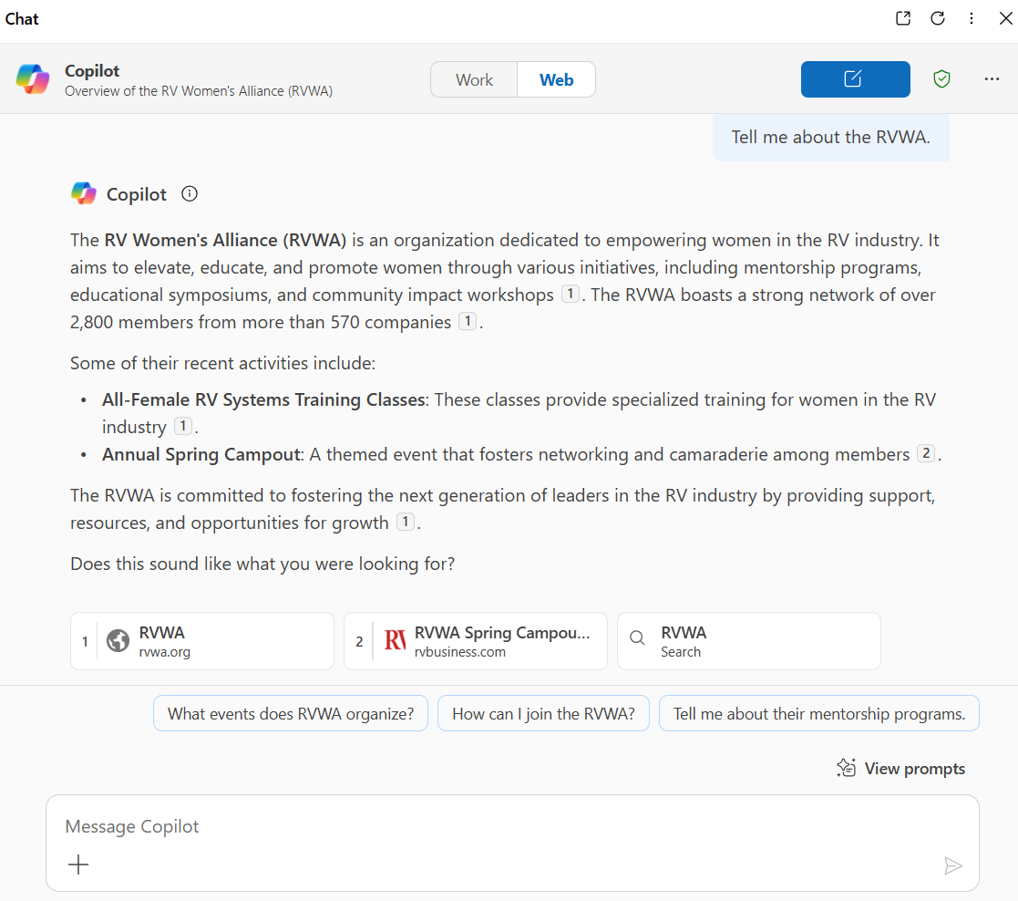
Using GenAI
Generative AI will revolutionize the way we access information. It is expected to replace most traditional algorithm design. Chances are you will end up using it daily without even realizing it. These tools are already beginning to be embedded in most used hardware and software.
That said, here are some tips to help you utilize it.
Define Clear Objectives: Before starting, have a clear understanding of what you want to achieve with GenAI. Whether it's content creation, data analysis, or automation, knowing your goals will help you use the technology more efficiently.
Provide Quality Input: The quality of the output depends heavily on the quality of the input. Make sure to provide detailed, accurate, and relevant information to get the best results. GIGO rules still apply!
Experiment and Iterate: Don't be afraid to experiment with different prompts and settings. Iteration can help you refine the outputs and discover new ways to leverage GenAI.
Understand Limitations: Be aware of the limitations of GenAI. It might not always provide perfect results, and understanding its boundaries can help you set realistic expectations and use it more effectively.
Stay Updated: GenAI technology is rapidly evolving. Keep yourself updated with the latest advancements, tools, and best practices to continuously improve your usage and stay ahead of the curve.

Slide 29
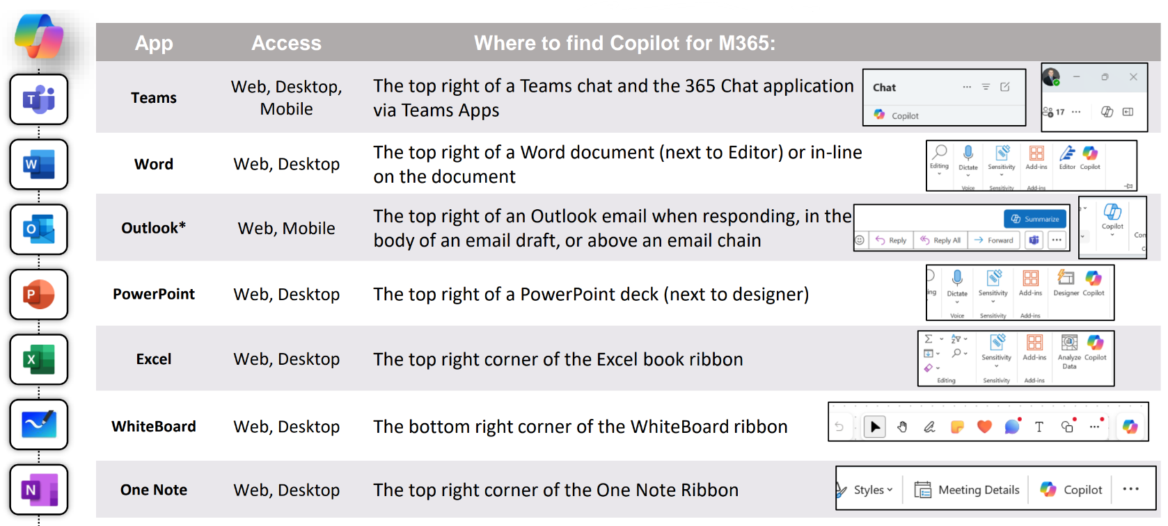
Embedded Applications (M365)

Slide 30
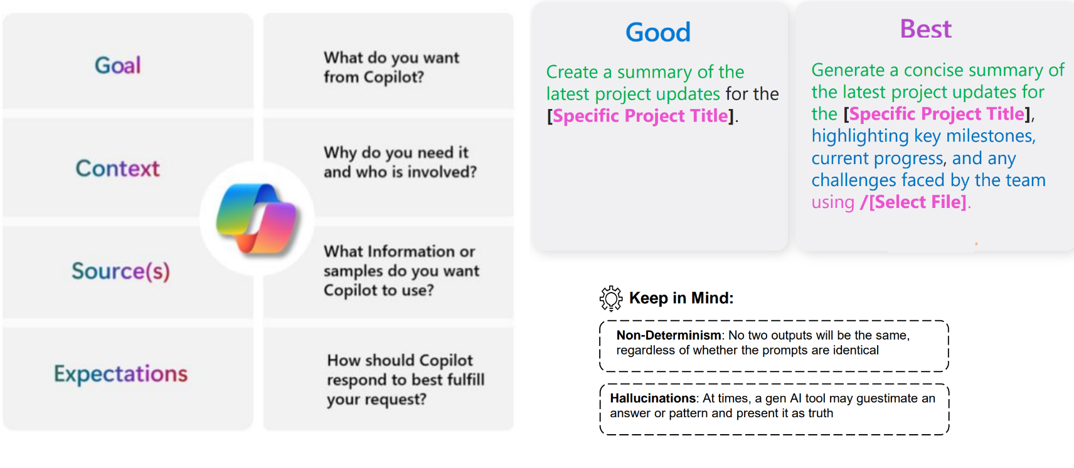
Prompting Tips

Slide 31

Generative AI Misconceptions
Generative AI is a new technology.
  It is just the next step on a very long journey. These newest versions are impressive though
AI is learning from me when I use it
  Based on the current technology, generative AI models do not learn and evolve on their own after the initial training process.
  After the initial training most foundational models are static
  The organizations that run these models are certainly collecting your data though
I can have my own custom AI model
  Very few organizations have the resources to build a new foundational model
  GPT-4 is estimated to have cost ~$63M to train (and this is with the data centers already available)
  Beware vendors who try to sell you your own “custom AI”
Generative AI will replace true human creativity and innovation
  It is a statistical model. It quasi-randomly emulates patterns.
  It will cannot be truly creative because it lacks the proper context and motivation.
It is impossible to distinguish human content from AI content
  The gap is certainly closing, but there are still ways to tell AI content from human content
  This will increasingly cause problems though as people are unable to distinguish between fakes and reality
Generative AI is better than human workers
  In some select areas, especially when it comes to processing huge amounts of data quickly, this can be true.
  However, the AI does not have true expertise or domain knowledge in most cases and is prone to errors and bias.
  Humans with AI will replace humans without. Just as we observed with computers.

Slide 32

Tips for handling AI vendors
Foundational Model: Ask what foundational model they are using (e.g., Llama from Meta, GPT from OpenAI, Gemini from Google, Claude from Anthropic). If they can't clearly articulate this, that is a red flag.
Custom Model: If they are selling "your own custom model," it means either Retrieval-Augmented Generation (RAG) or fine-tuning.
  Fine-tuning: They will need annotated training data from your organization. Ensure they are clear on the costs to train, the data requirements, and the expected performance upfront.
  RAG: Understand their vector retrieval (search engine) system and the costs associated with maintaining it.
Data Security: If data security is a concern, ask whether the models will be hosted on-prem or in the cloud. Clarify if they have protected endpoints or if they are using public services.
Past Success Stories: Always ask for past success stories. You don't want to be a start-up's first attempt.
Regulatory Compliance: The regulatory landscape is a mess right now. Protect yourself and make that their responsibility. You may want indemnifications in place, especially if the application is public-facing
Buyer Beware

Slide 33
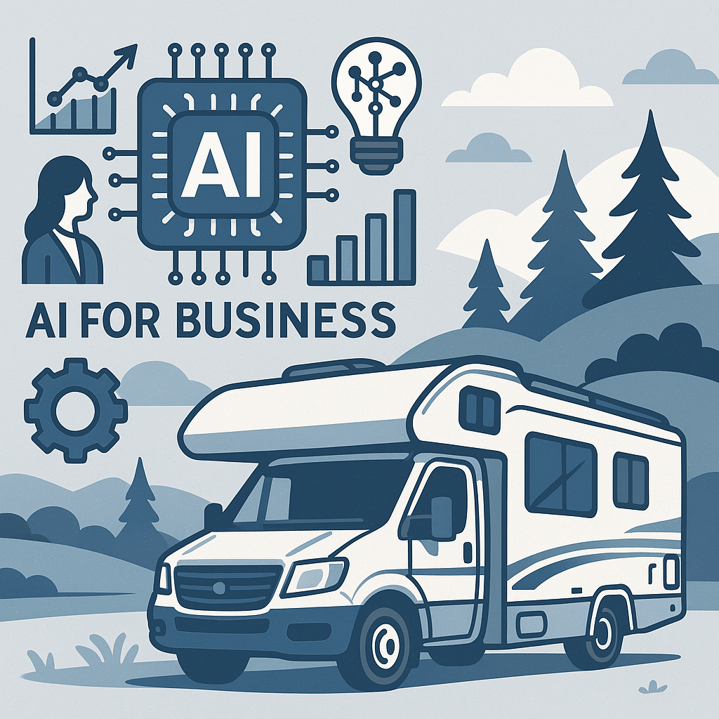
Future of AI in the RV Industry
Trip Planning and Navigation
AI-powered trip planners like AdventureGenie help RVers map out routes, stops, and attractions based on preferences 1.
Tools like ChatGPT and Google Gemini are being used to create personalized travel itineraries.
Predictive Maintenance and Diagnostics
60% of RV service centers now use AI diagnostic tools to reduce repair times
Predictive maintenance powered by AI has decreased RV breakdowns by 30%, identifying issues before they become critical.
Smart Features and In-Vehicle Assistants
AI-enabled voice assistants and entertainment systems are enhancing user experience, with 65% of RV owners expressing interest in these features
AI-enhanced multimedia systems have increased customer engagement by 25%.
Pricing and Market Insights
49% of RV rental platforms use AI to customize pricing strategies, increasing revenue by 20%
AI is also used to forecast demand and optimize fleet availability with 85% accuracy.
Customer Service
AI chatbots are being used by RV dealerships and rental platforms to handle service requests and customer inquiries—40% of service requests are now initiated this way
Virtual tours and AI-powered CRM systems are improving the buying experience and boosting conversion rates.
Sales
Cross-selling, market whitespace analysis, lead tracking and follow-up & customer alerts systems for your CRM. Marketing strategy planning and content generation using live web driven marketing
The AI – Transformable Home (AI-TH)
AC-Future
Ai In The Rv Industry Statistics Statistics: Market Data Report 2025

Slide 34
Resources & Further Reading
Some commercial speculation about AI enabled RV technology:
The AI RV Revolution: 10 Ways Technology is Transforming Road Trips in 2025 - RV Judge – RV Living, Gear Reviews & Camping Tips
The Transformative Role of AI in RV Innovations and Mobility | by Robert Gutierrez | Medium
New Veo3 video generation capabilities now come with automatic dialogue generation and sync:
Linus Ekenstam on X: "WE CAN TALK!! Unofficial ad for VEO3 by @arikuschnir https://t.co/NzSJOLjeJE" / X
Ernst and Young market report on the future of AI:
https://www.ey.com/en_us/insights/emerging-technologies/future-of-ai
A comprehensive breakdown of GenAI by the creator of Wolfram Alpha:
What Is ChatGPT Doing … and Why Does It Work?—Stephen Wolfram Writings
A highly speculative piece on the potential future of AI. Fun read though:
AI 2027
An easy-to-follow primer on math modeling:
Mathematical Models

Slide 35

Questions & Answers

